Slide 1
Team 13 Ecommerce Store
<10/5/2025>

Slide 2
Team Members
<//
//>
Mohamed Hany Mohamed Fadel | 21P0299
Saifeldin Mohamed Hatem | 21P0186
Ahmed Mohamed Ibrahim Elsheikh | 21P0109
Belal Anas | 21P0072
Mazen Ahmed Galal | 21P0103
Ahmad Abdelmaksoud | 2101077

Slide 3
Table of contents
01
02
03
04
<//
//>
Frontend
Backend
Database
Conclusuion

Slide 4
Table of contents
01
<//
//>
Frontend

Slide 5
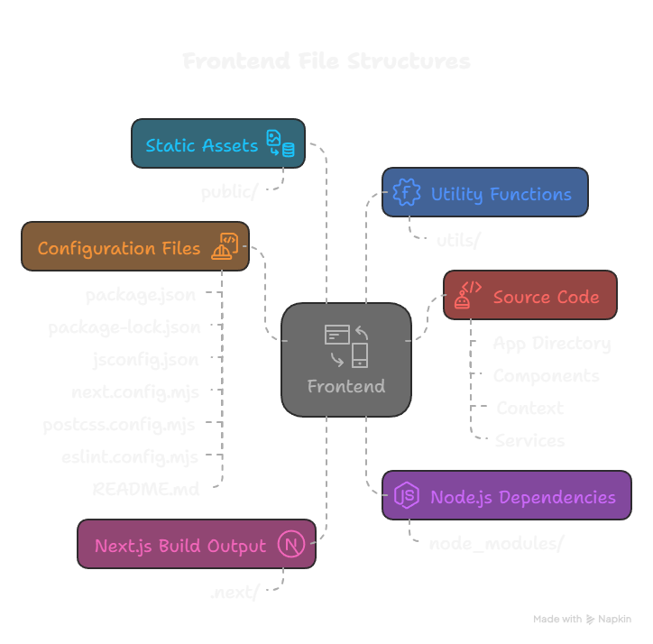
Frontend
<//
//>

Slide 6
Main Page
<//
//>

Slide 7
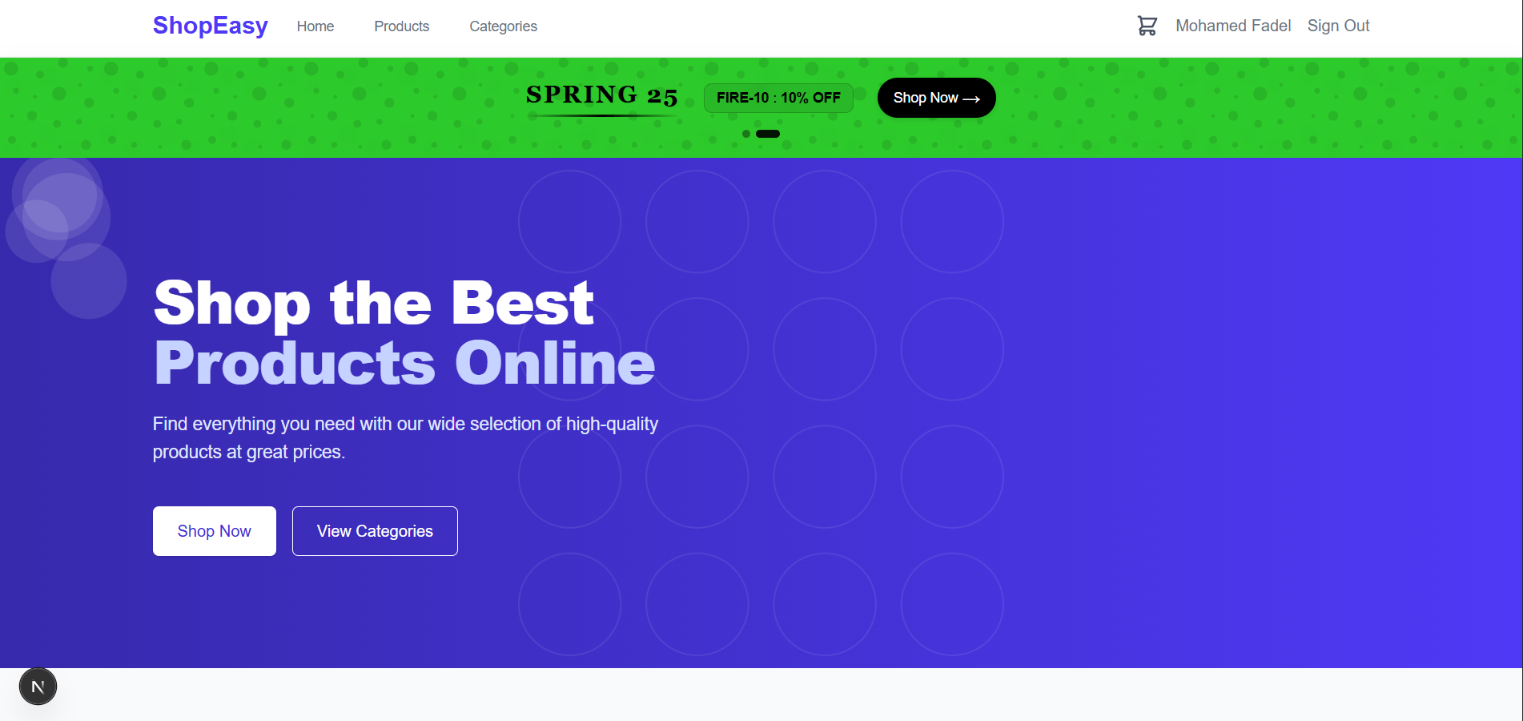
Main Page

Slide 8
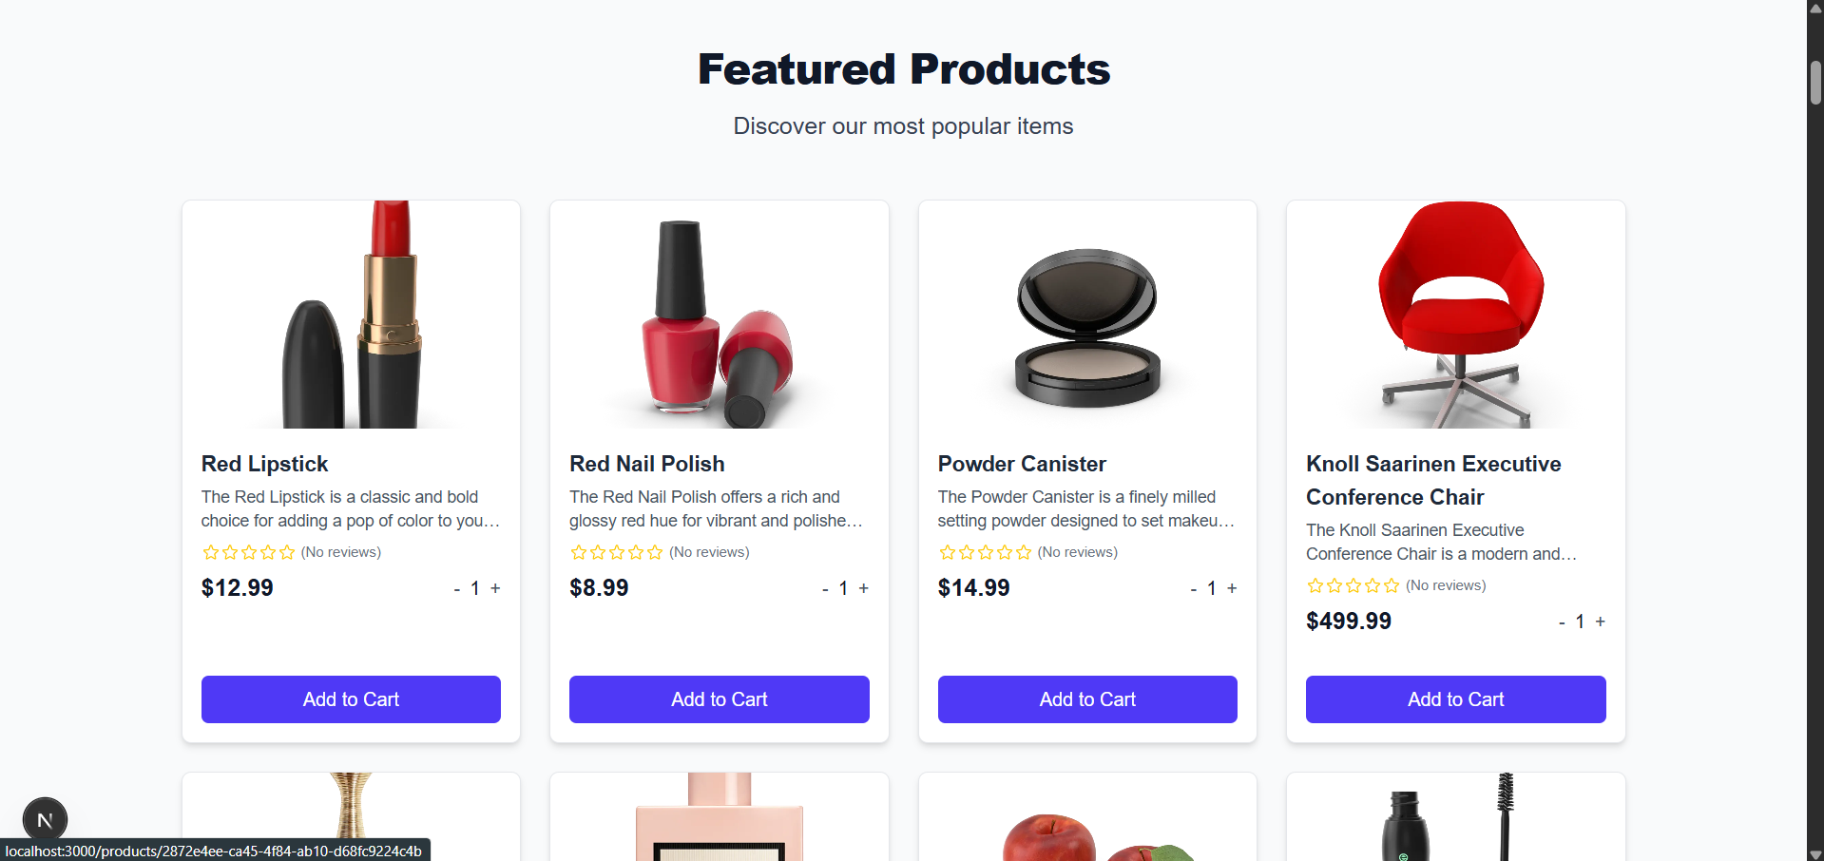
Main Page

Slide 9
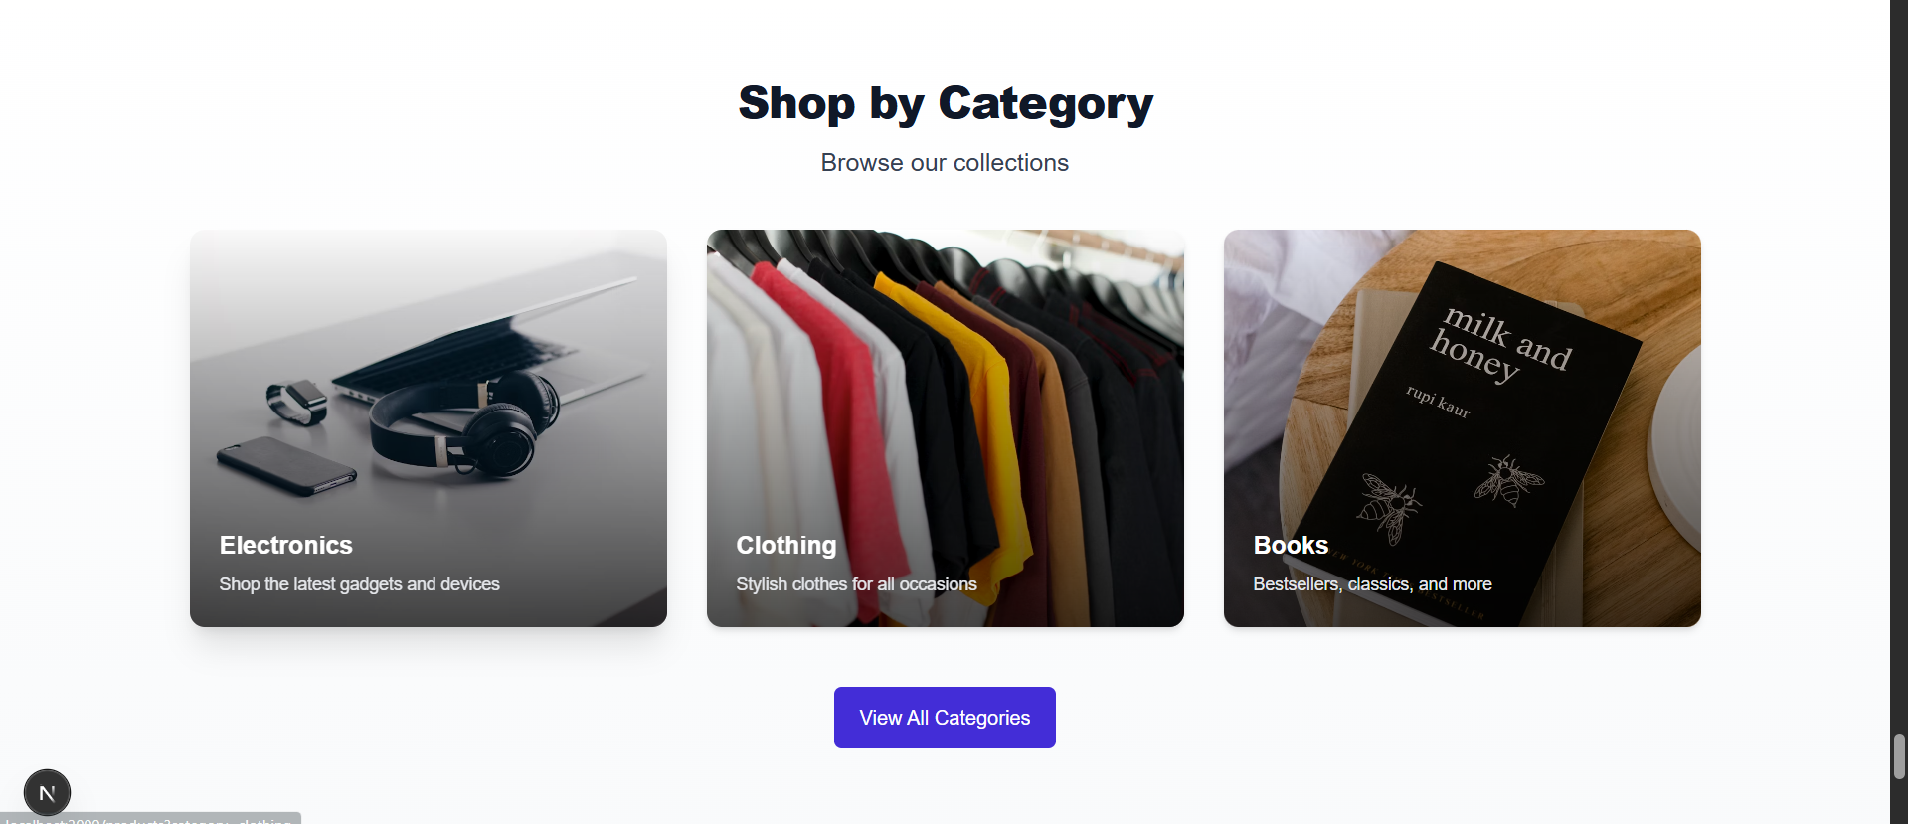
Main Page

Slide 10
Product Page
<//
//>

Slide 11
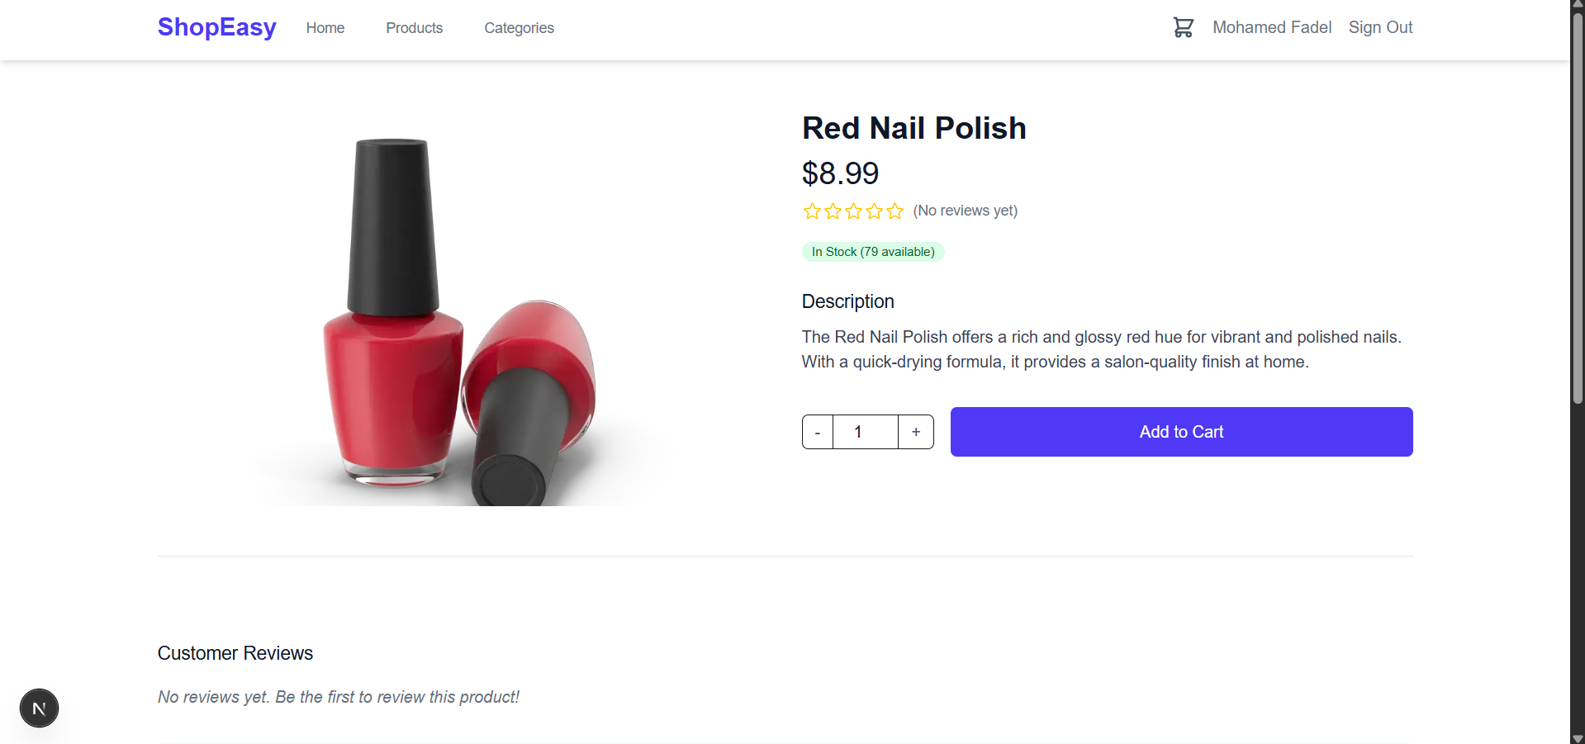
Product Page

Slide 12
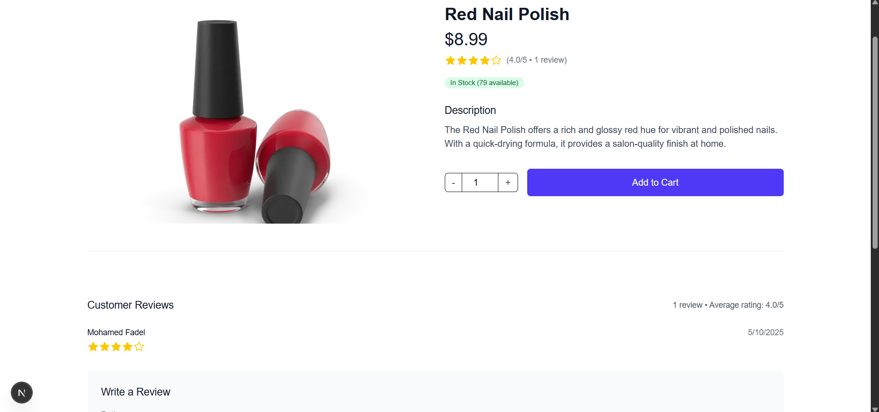
Product Page (review)

Slide 13
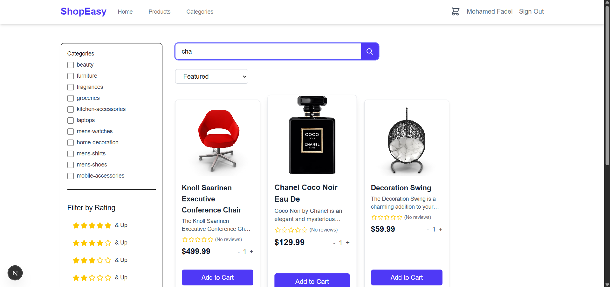
Product Page (Search Functionality)

Slide 14
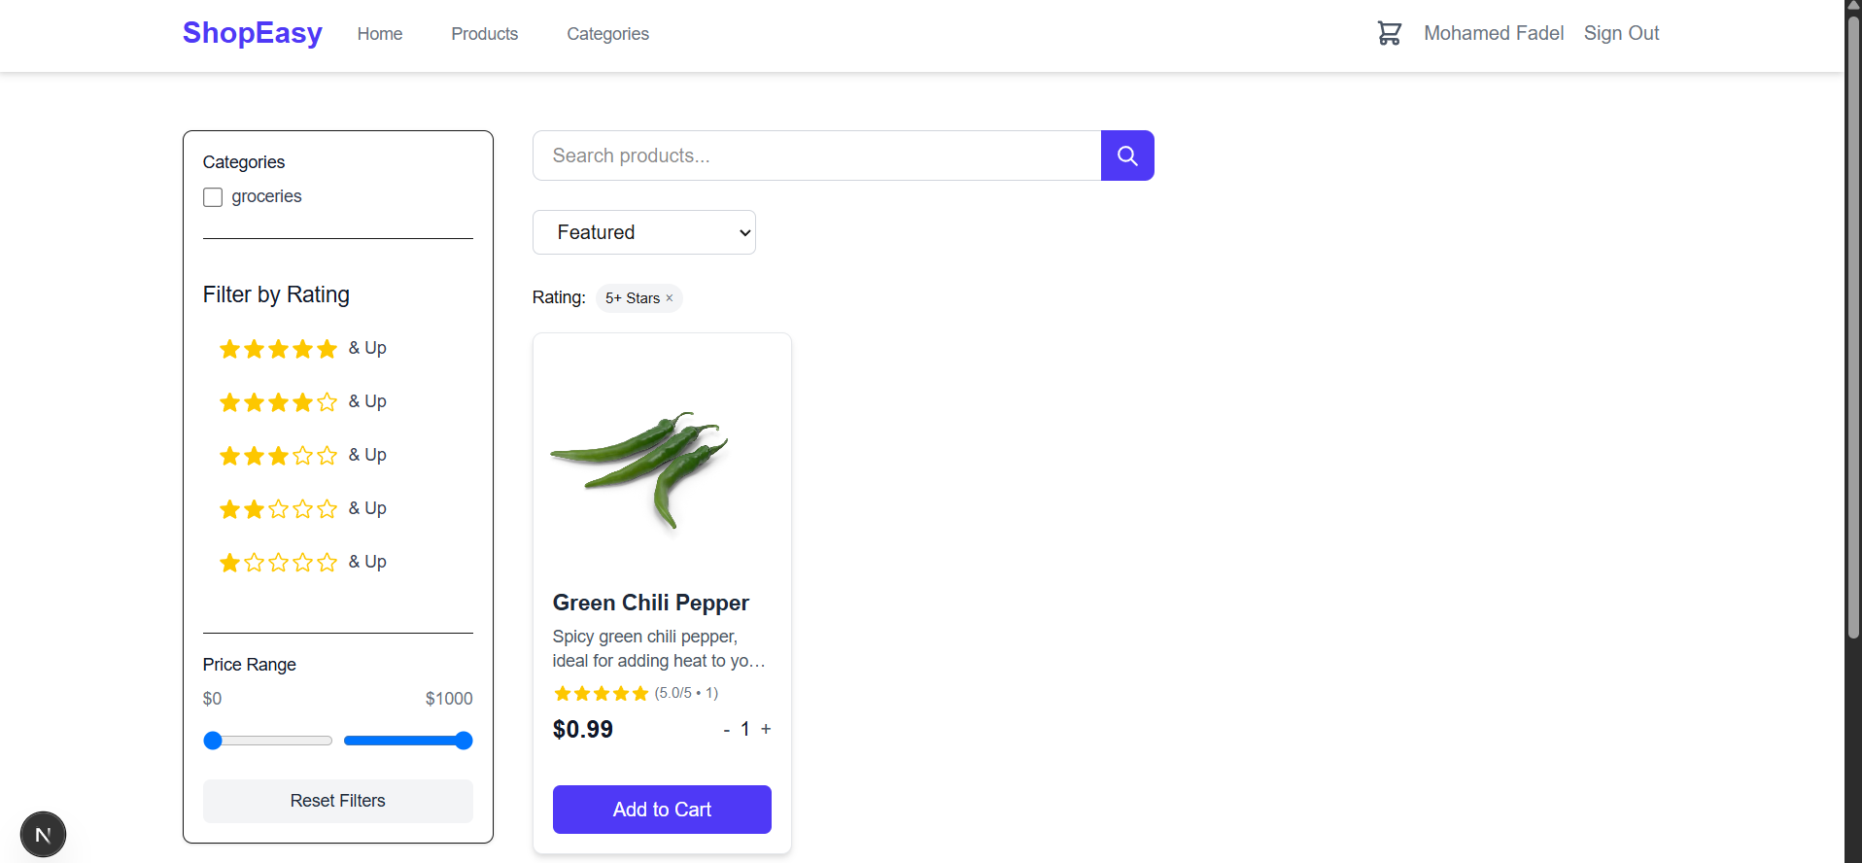
Product Page (Filter by Reviews)

Slide 15
Product Page ( Filter by Price and search)

Slide 16
Product Page (Sort)

Slide 17
Categories Page
<//
//>

Slide 18
Categories

Slide 19
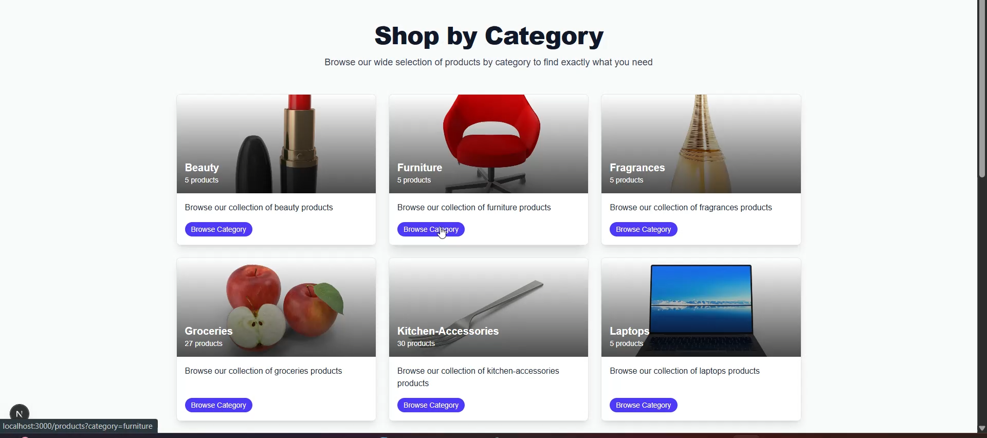
Categories

Slide 20
Order Page
<//
//>

Slide 21
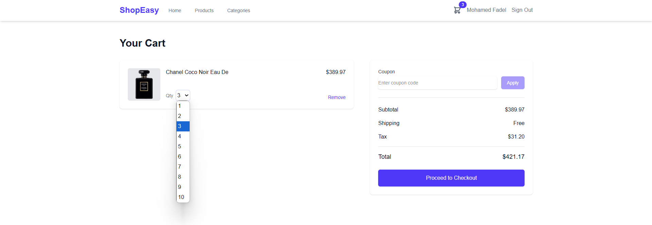
Order Page

Slide 22
Order Page (using promocode)

Slide 23
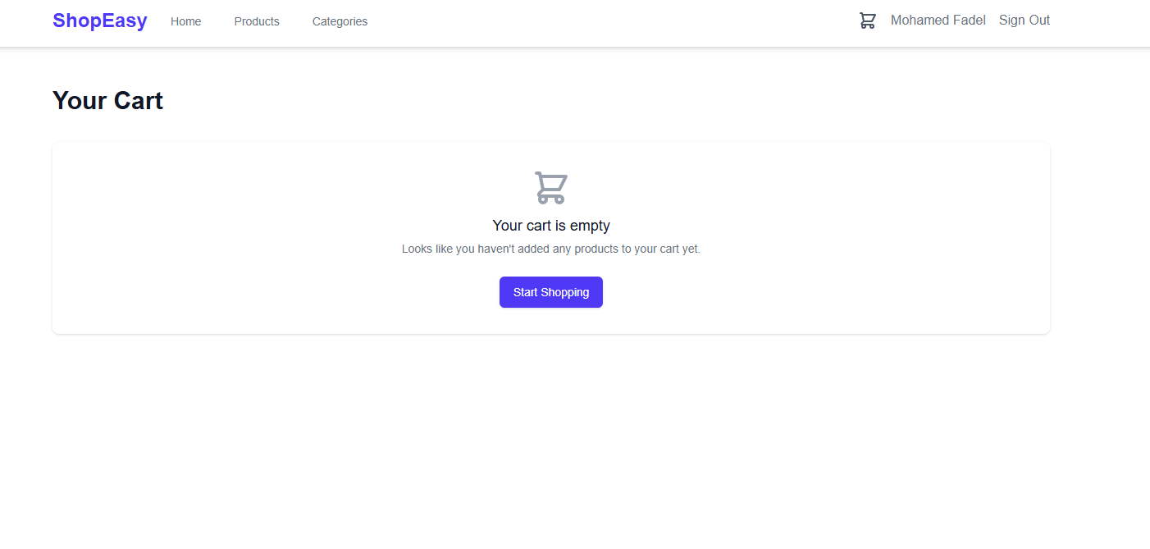
Order Page (Empty Cart)

Slide 24
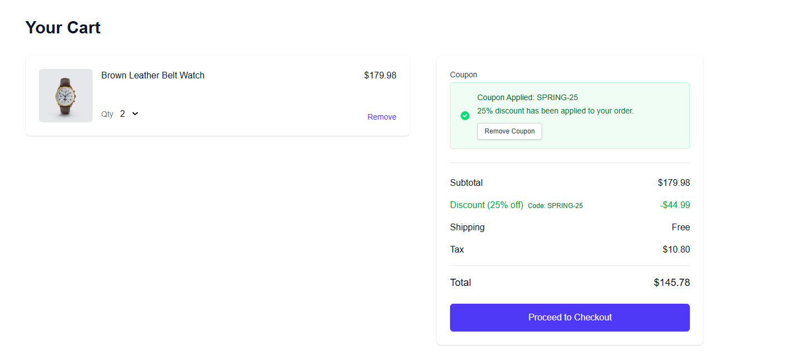
Order Page (Applying Coupon)

Slide 25
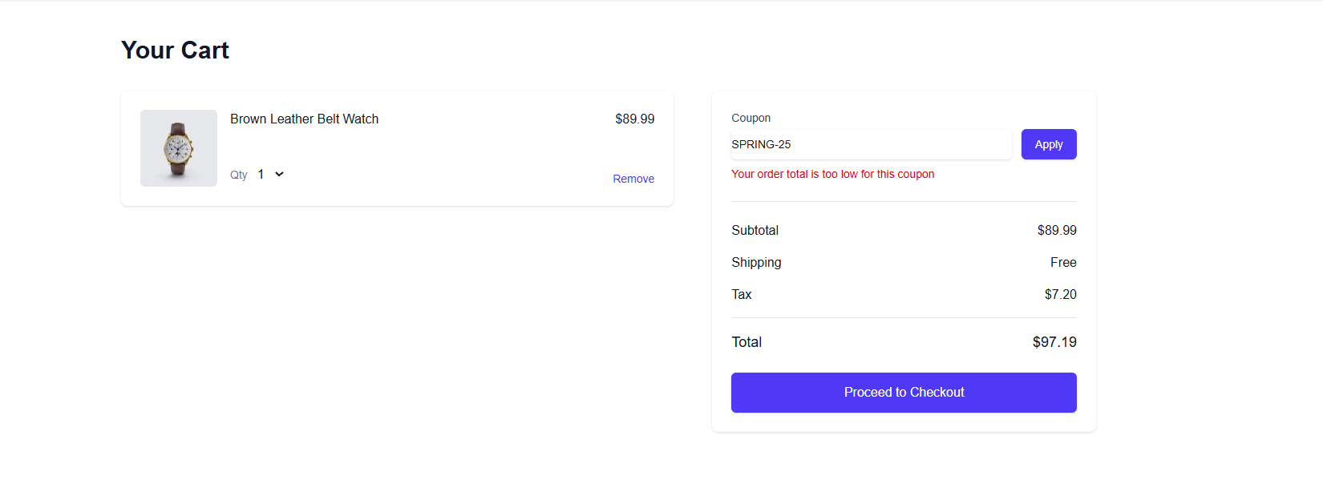
Order Page (Coupon not Applied)

Slide 26
Checkout Page
<//
//>

Slide 27
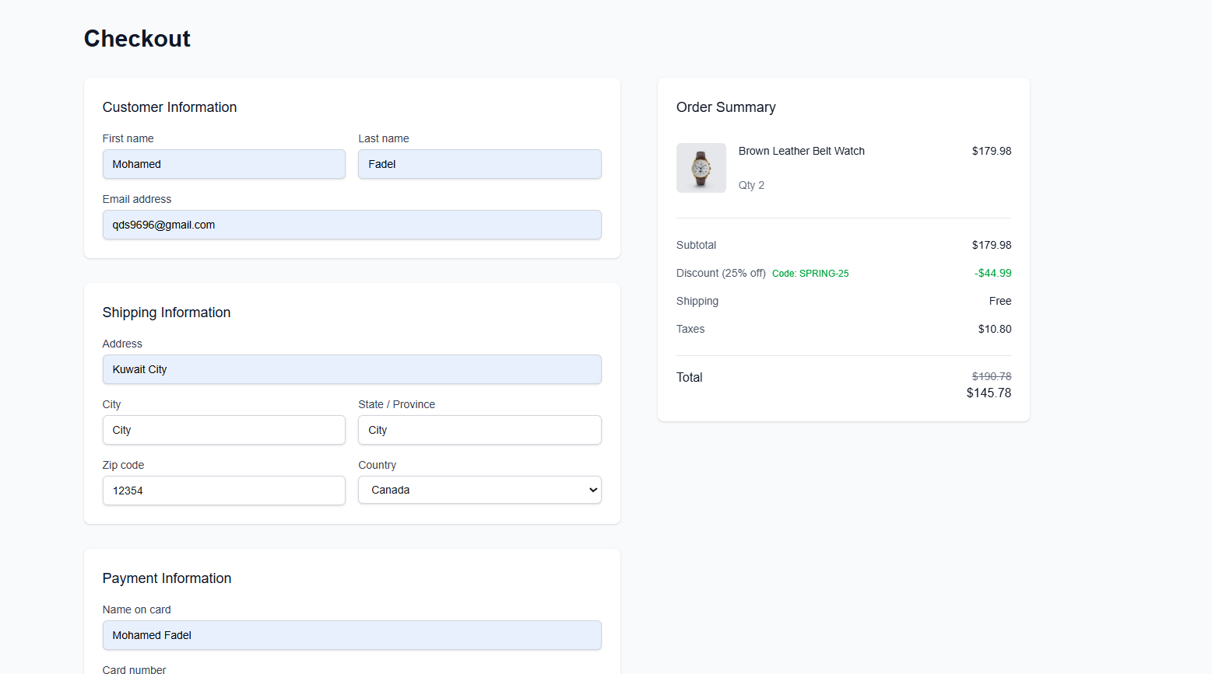
Checkout Page

Slide 28
Order Reciept Page
<//
//>

Slide 29
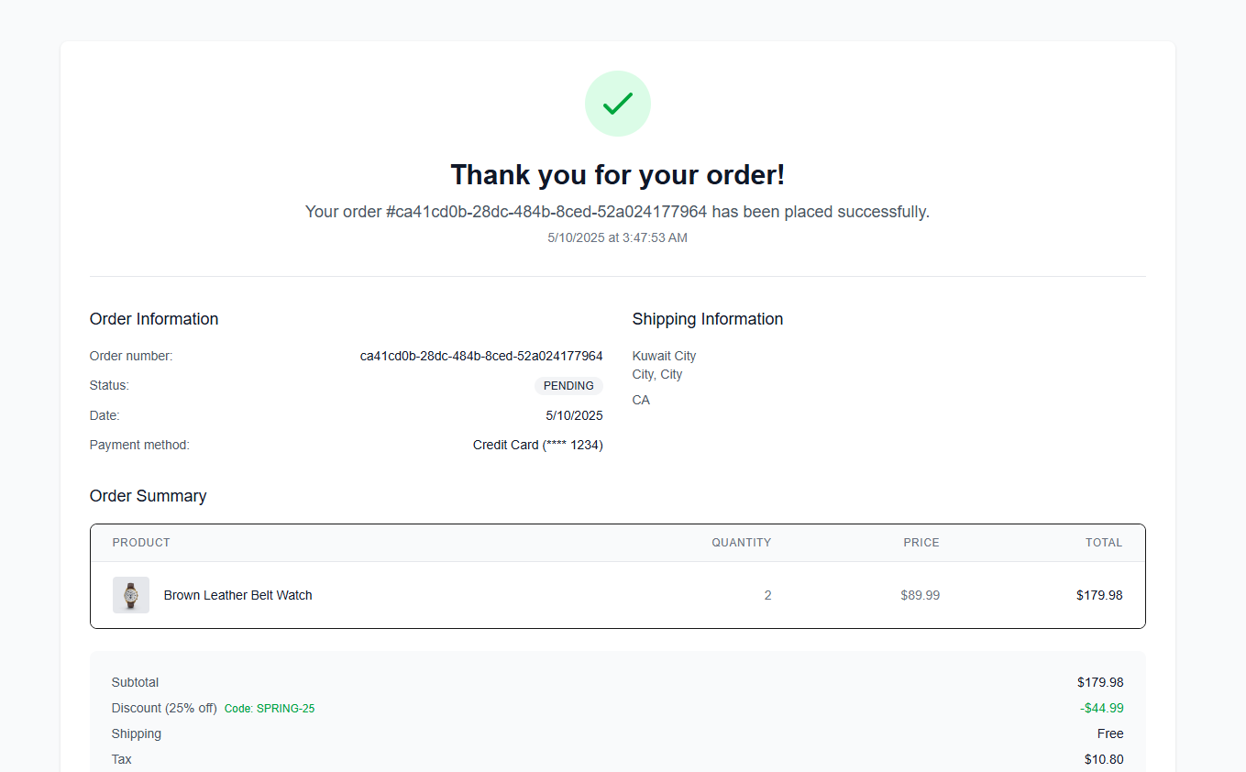
Order Reciept Page

Slide 30
Order History Page
<//
//>

Slide 31
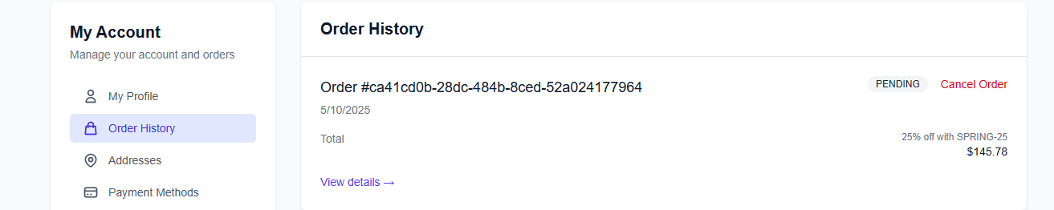
Order History Page

Slide 32
Login / Register Page
<//
//>

Slide 33
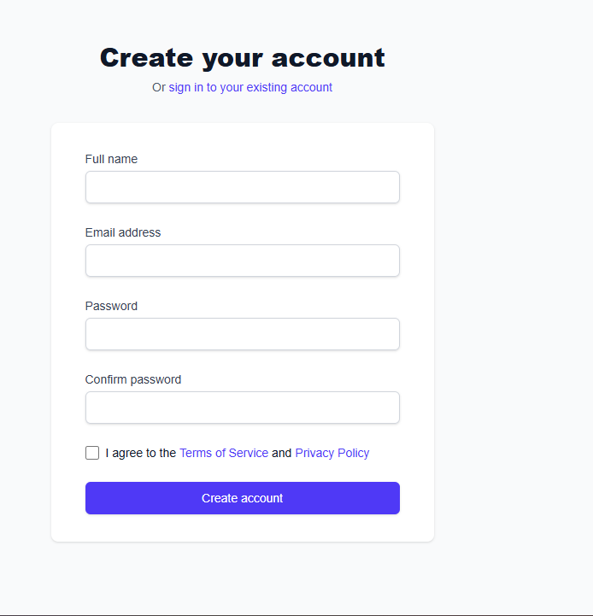
Register Page

Slide 34
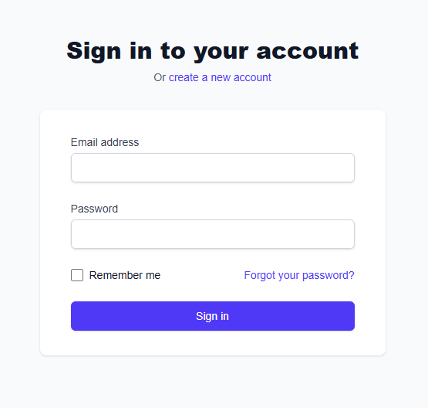
Login Page

Slide 35
Admin Panel Page
<//
//>

Slide 36
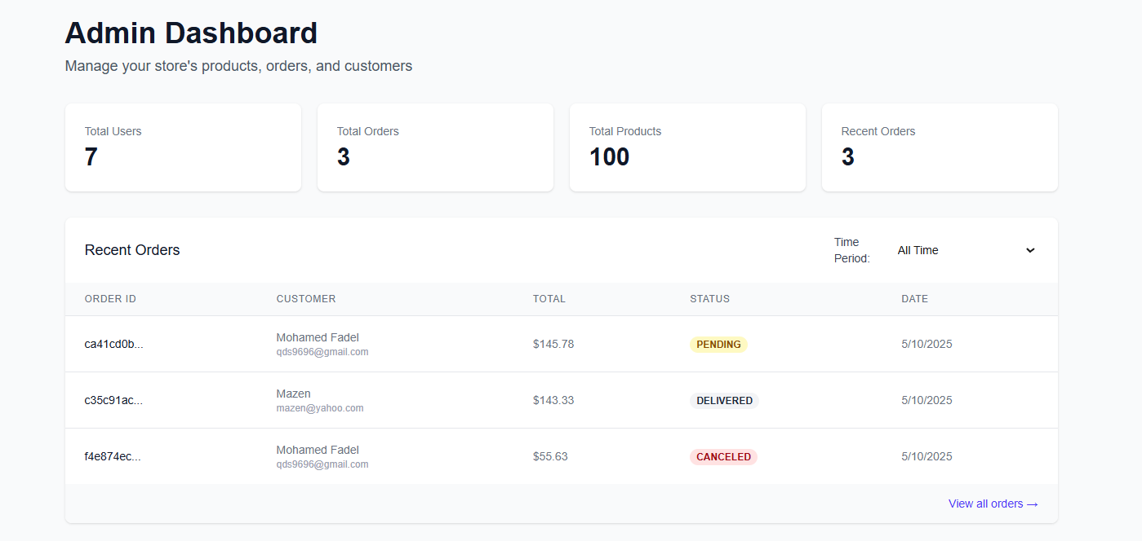
Admin Panel

Slide 37
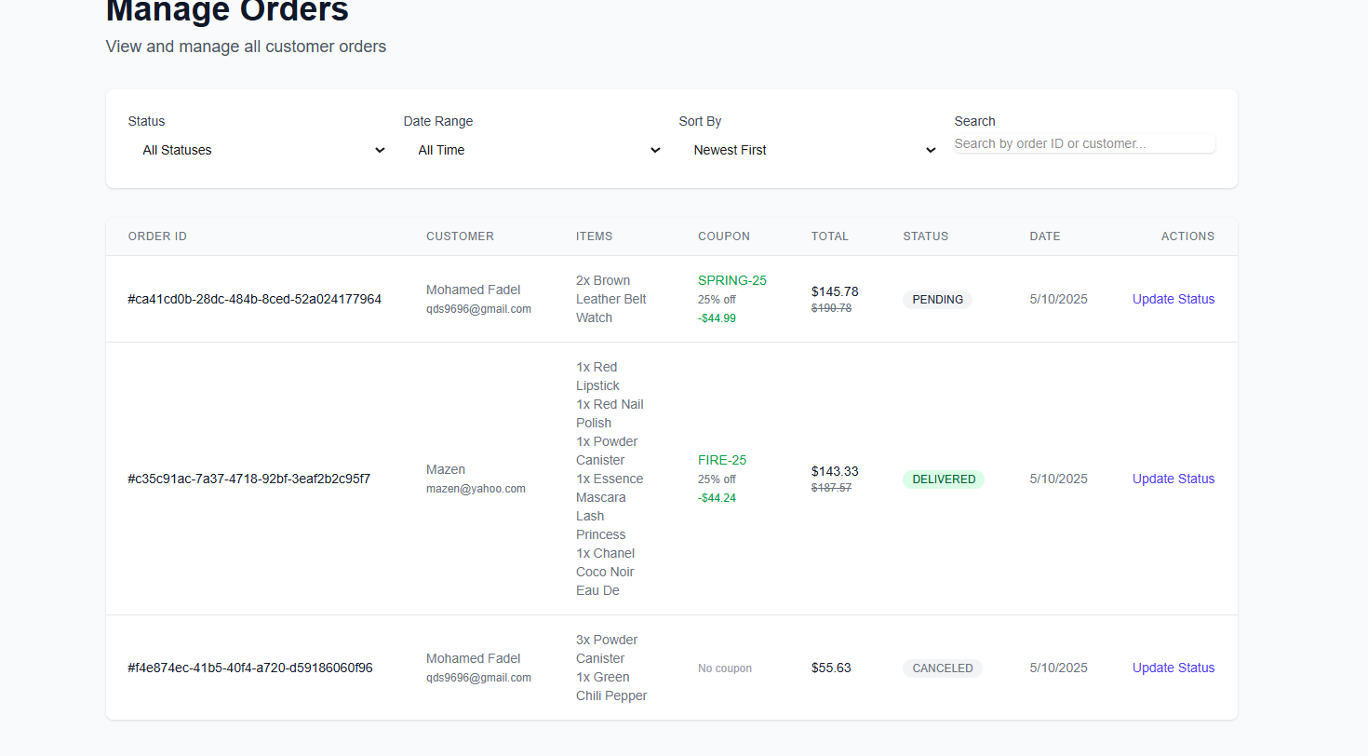
Manage Orders

Slide 38
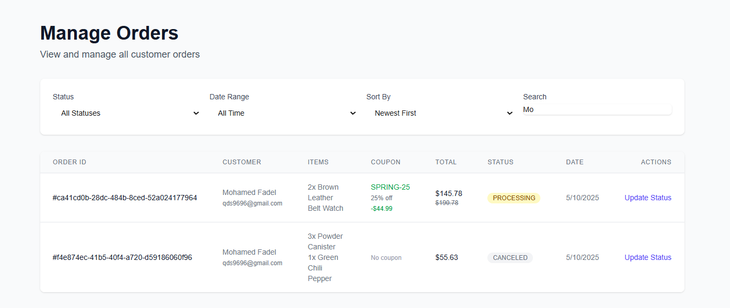
Manage Orders Search

Slide 39
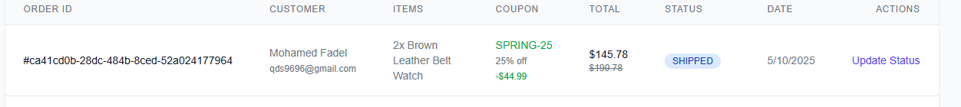
Manage Orders Update Orders State

Slide 40
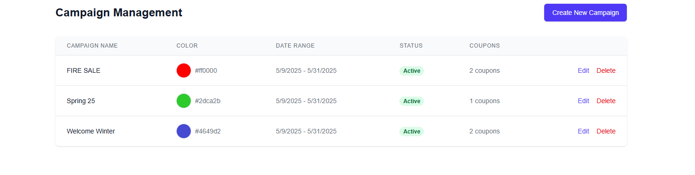
Managing Campaigns

Slide 41
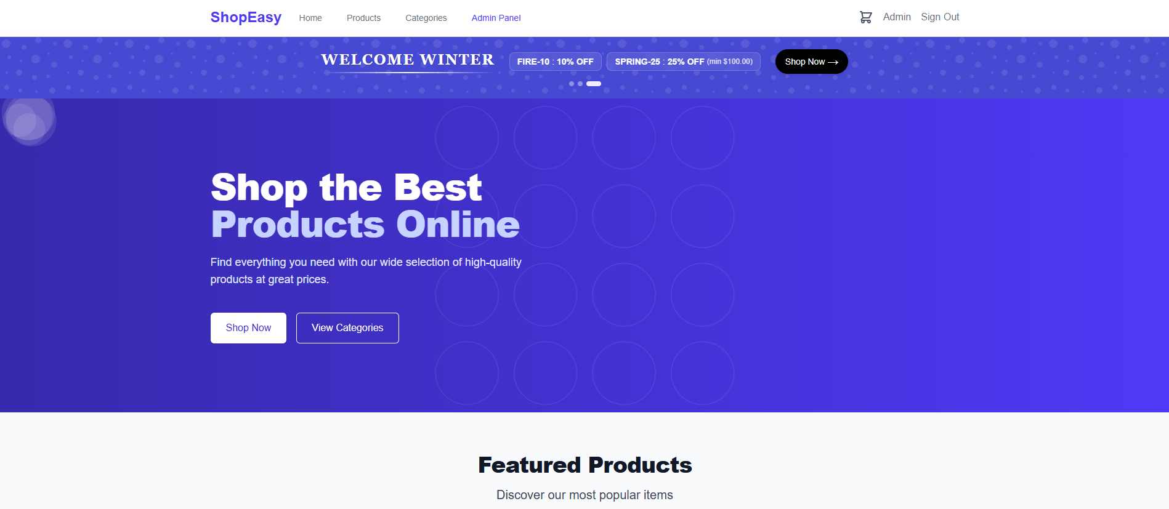
Campaigns Shows in the Home Page

Slide 42
Table of contents
01
<//
//>
Frontend

Slide 43
Table of contents
01
02
03
04
<//
//>
Frontend
Backend
Database
Conclusuion

Slide 44
Table of contents
02
<//
//>
Backend

Slide 45
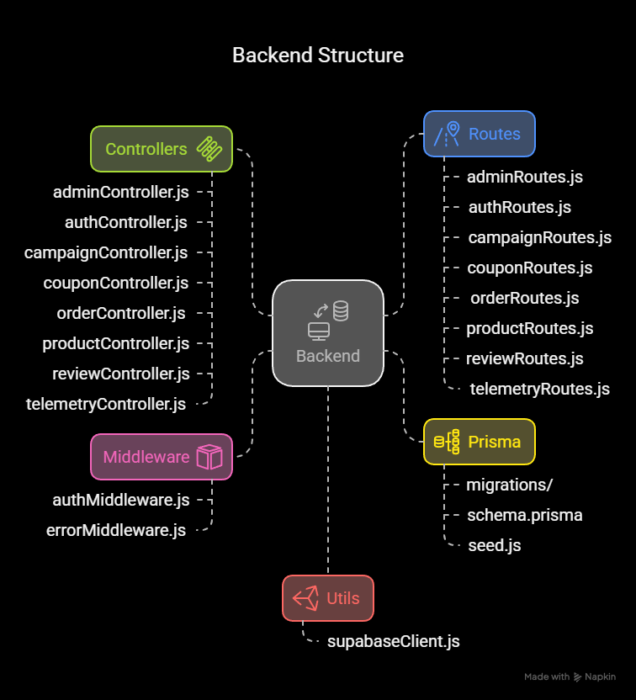
Backend
<//
//>

Slide 46
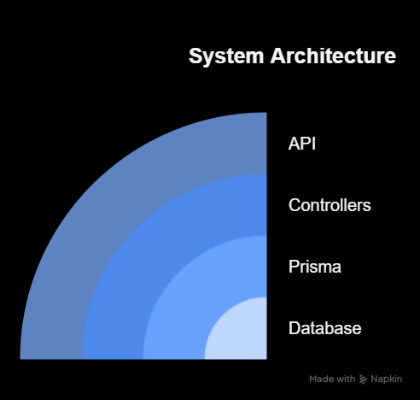
Backend
<//
//>

Slide 47
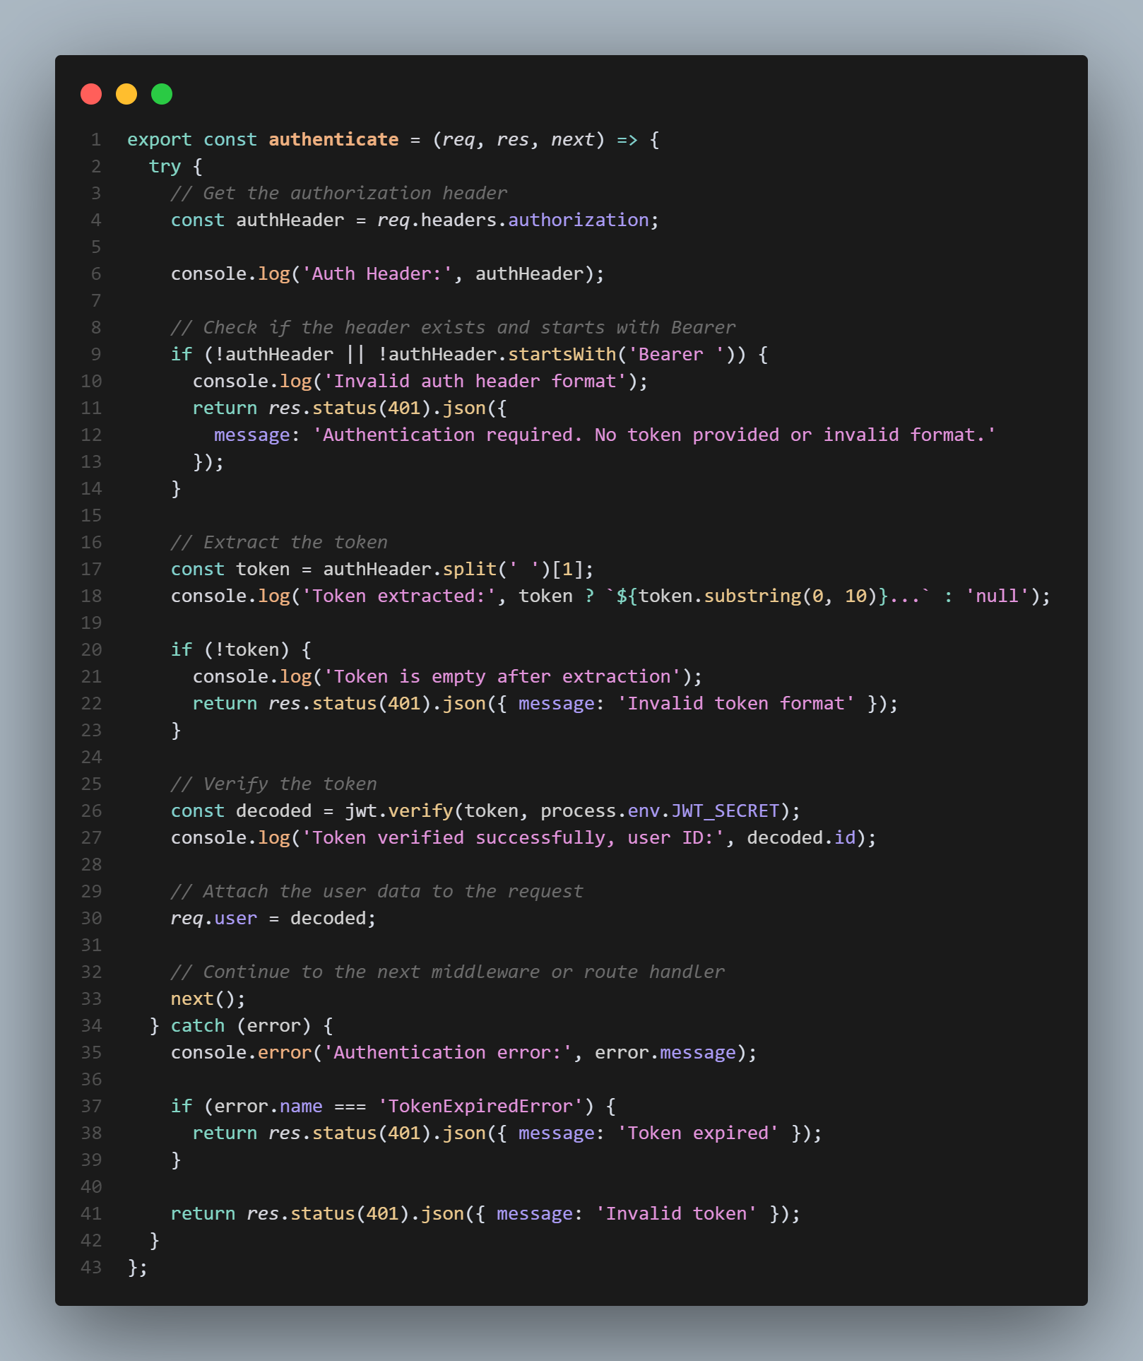
Authentication
<//
//>

Slide 48
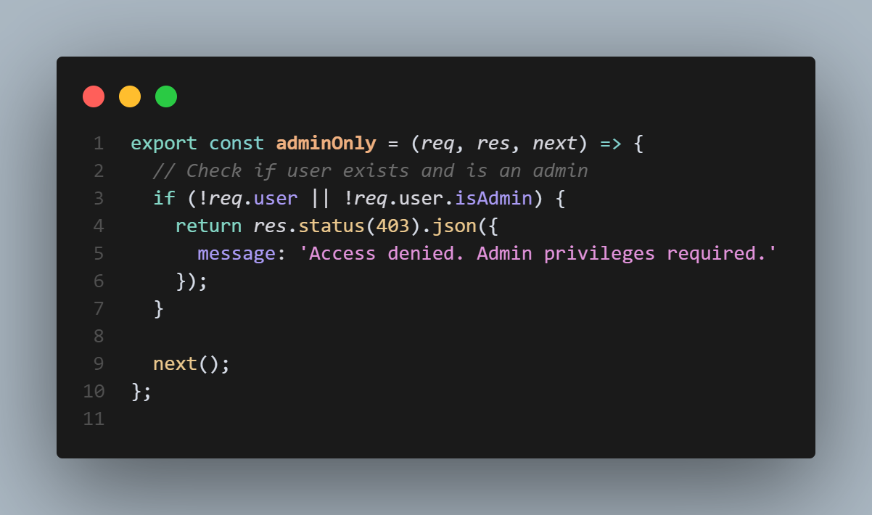
Authentication
<//
//>

Slide 49
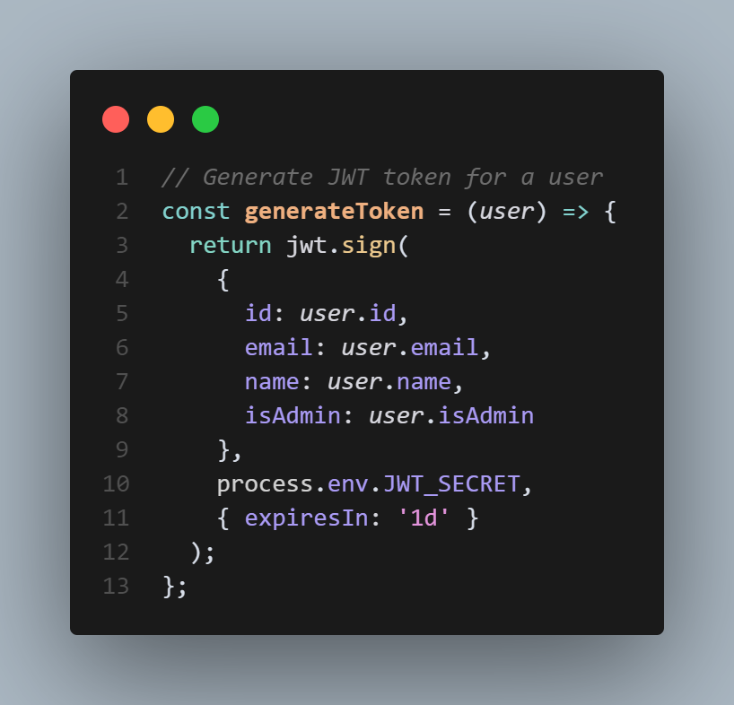
JWT token Generator
<//
//>

Slide 50
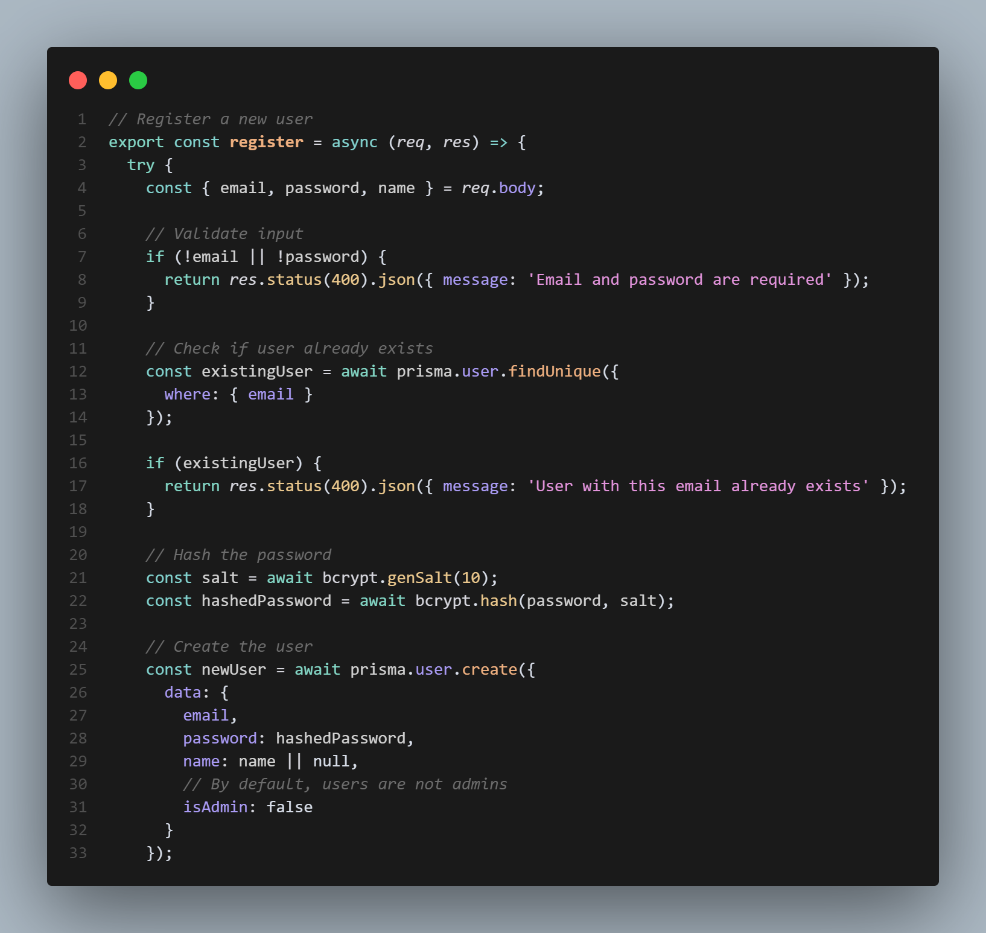
User Registration
<//
//>

Slide 51
User Login
<//
//>

Slide 52
How it works
<//
//>
Authentication in this backend is implemented using JWT (JSON Web Token) and enforced via Express middleware. When a user successfully logs in or registers, the backend generates a JWT using the user’s ID, email, name, and isAdmin flag, signing it with a secret key (process.env.JWT_SECRET). This token is returned to the client and must be included in the Authorization header as a Bearer token for all protected API requests.The authenticate middleware extracts the token from the header, verifies its signature and expiration using the same secret, and decodes the payload. The decoded user data is then attached to req.user for downstream access. For role-based access, the adminOnly middleware checks req.user.isAdmin and only allows requests from users with admin privileges..”

Slide 53
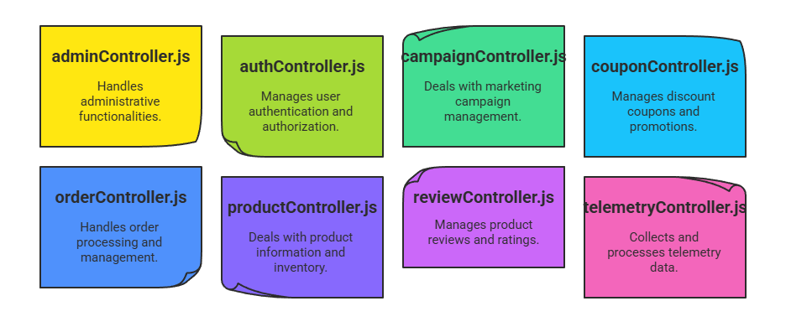
Controllers
<//
//>

Slide 54
adminController
<//
//>
Handles admin-specific operations, such as generating dashboard statistics, managing site-wide metrics, and providing endpoints that are only accessible to admin users.

Slide 55
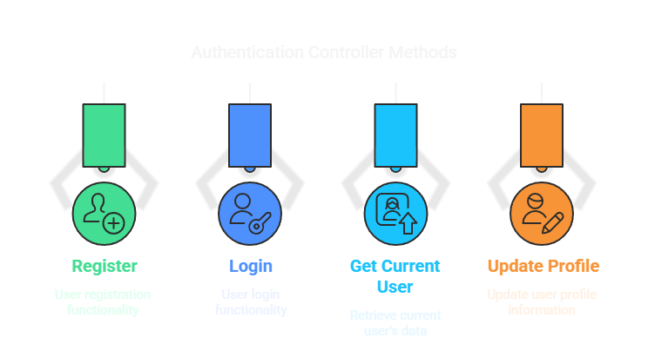
authController
<//
//>

Slide 56
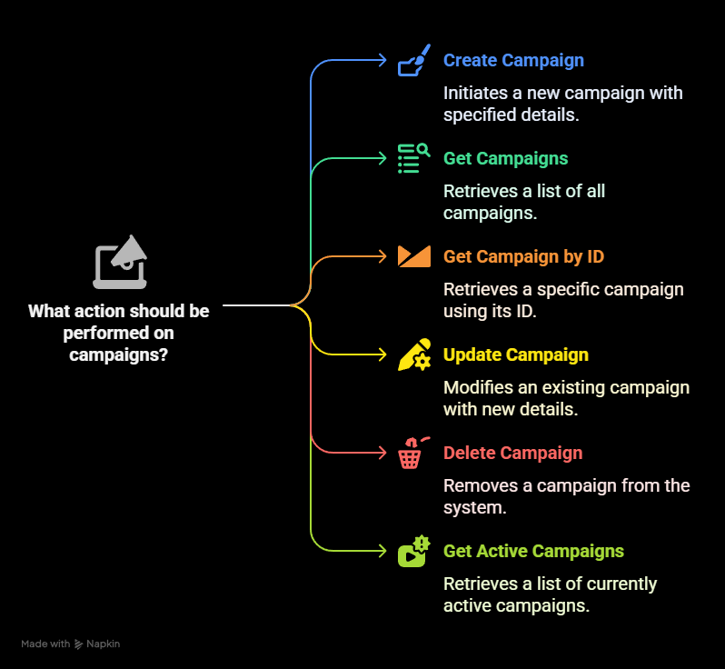
campaignController
<//
//>

Slide 57
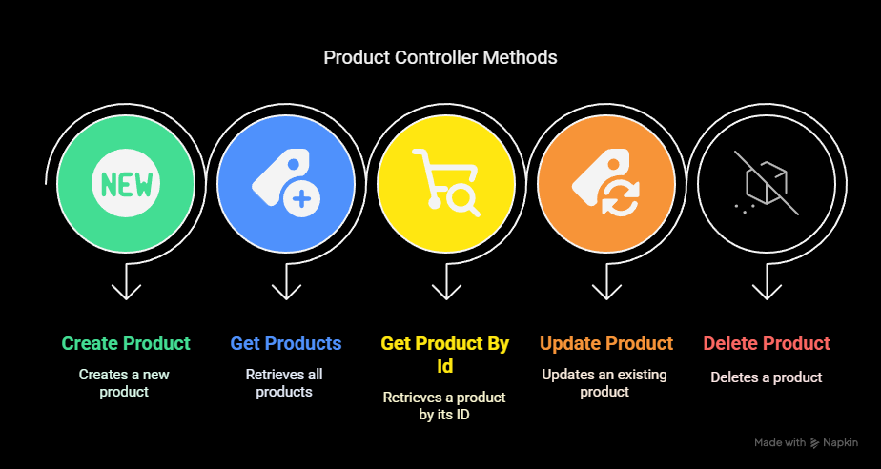
productController
<//
//>

Slide 58
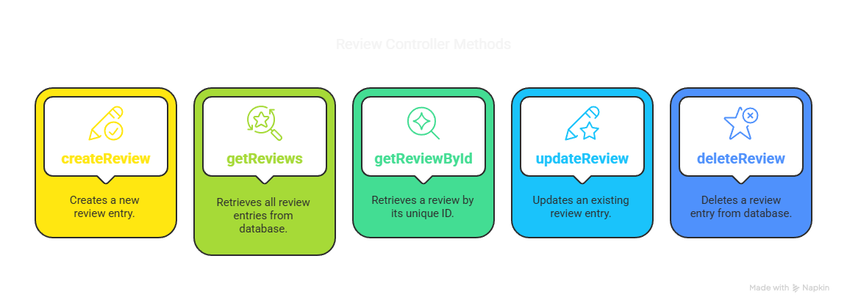
reviewController
<//
//>

Slide 59
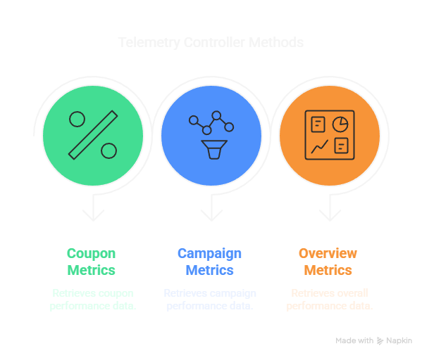
telemetryController
<//
//>

Slide 60
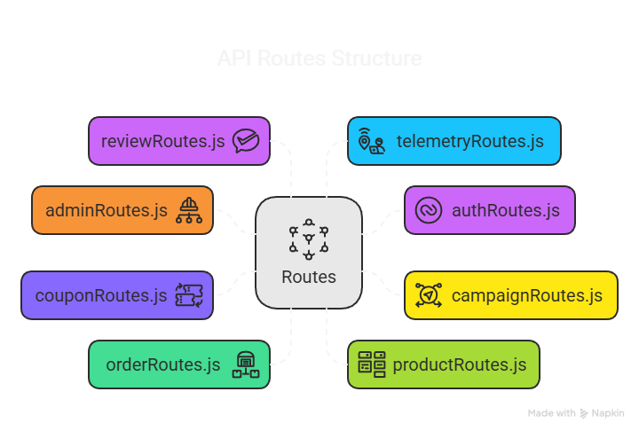
Routes
<//
//>

Slide 61
Table of contents
02
<//
//>
Backend

Slide 62
Table of contents
01
02
03
04
<//
//>
Frontend
Backend
Database
Conclusuion

Slide 63
Table of contents
03
<//
//>
Database

Slide 64
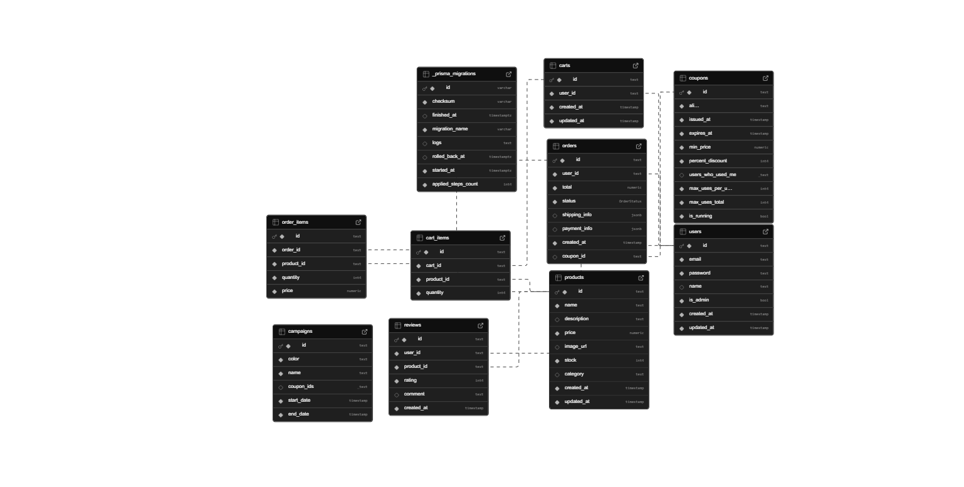
Schema
<//
//>

Slide 65
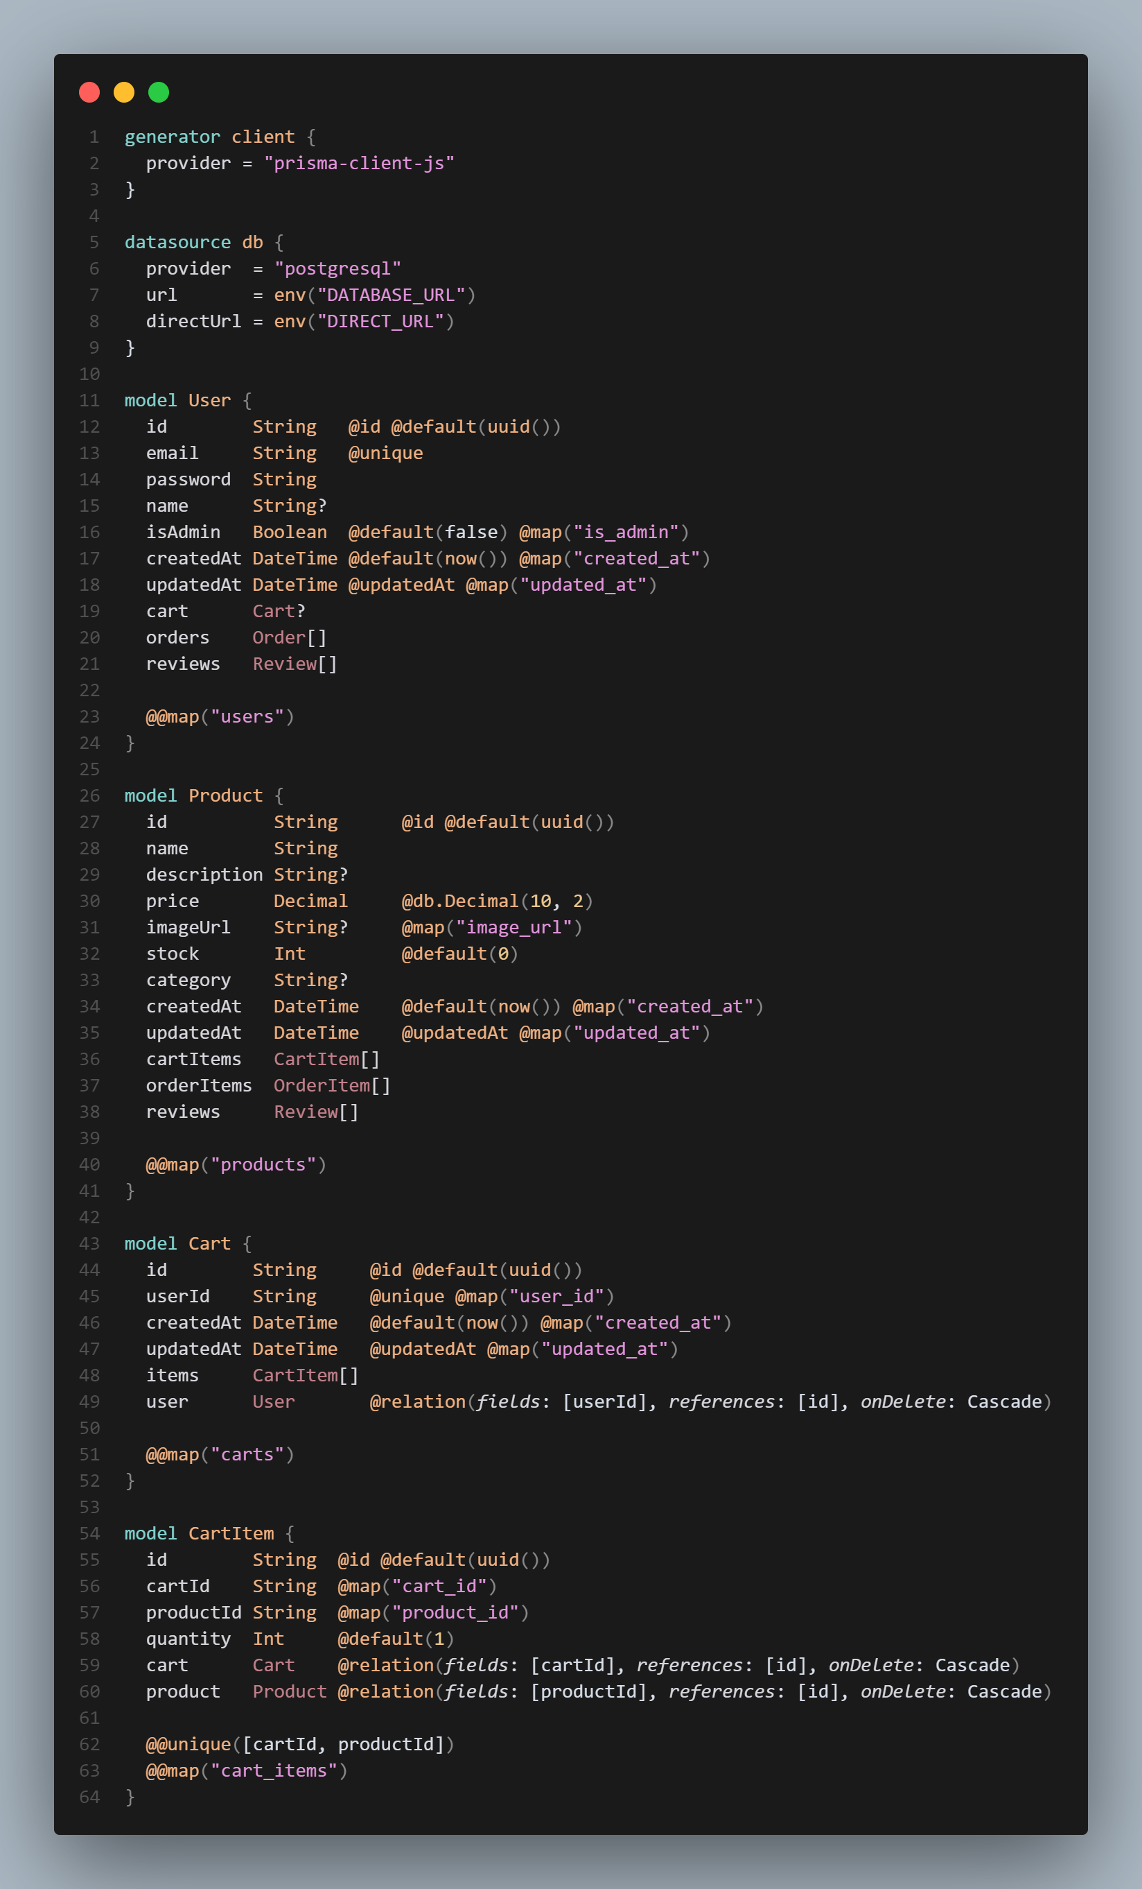
Schema.prisma
<//
//>

Slide 66
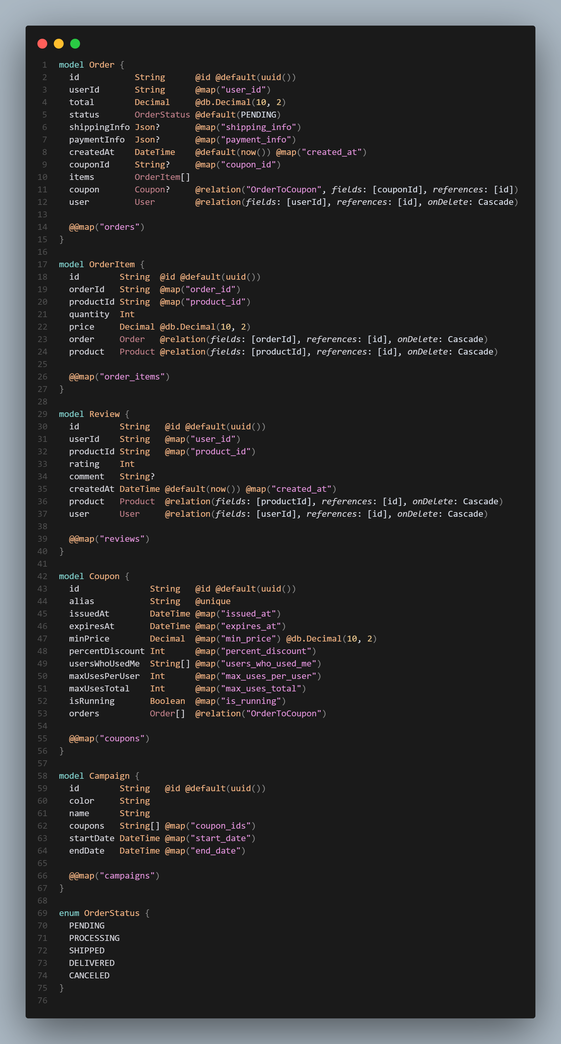
Schema.prisma
<//
//>

Slide 67
Table of contents
03
<//
//>
Database

Slide 68
Table of contents
01
02
03
04
<//
//>
Frontend
Backend
Database
Conclusuion

Slide 69
Table of contents
04
<//
//>
Conclusion

Slide 70




Technologies used in Frontend
<//
//>

Slide 71



Technologies used in Backend
<//
//>

Slide 72


Technologies used in Database
<//
//>

Slide 73


Technologies used in Authentication & Security
<//
//>

Slide 74
Table of contents
04
<//
//>
Conclusion

Slide 75
Table of contents
01
02
03
04
<//
//>
Frontend
Backend
Database
Conclusuion

Slide 76
Thank you

